Slide 1


Green Pace
Security Policy Presentation
Developer: Musab Sagri
Notes:
“Hello, my name is Musab Sagri. This presentation outlines the proposed Green Pace Security Policy, including secure coding practices, testing methods, and security automation strategies.”

Slide 2

OVERVIEW: DEFENSE IN DEPTH
The Green Pace Security Policy ensures layered protection across all systems and processes. As the development team expands, maintaining consistent secure practices becomes essential. This policy supports a defense-in-depth strategy through multiple layers, physical, network, application, and governance, helping detect and prevent vulnerabilities before they can be exploited.
Notes:
“The Green Pace Security Policy provides strong protection by using multiple layers of security such as physical, network, application, and governance. As the development team grows, this policy helps ensure everyone follows secure practices and prevents vulnerabilities before they become problems.”

Slide 3
THREATS MATRIX
Input validation errors (e.g., buffer overflows) Improper error handling | Injection attacks (e.g., SQL injection, command injection) Broken authentication
Insecure logging Exposed debug code | Insider threat Side-channel attacks
Notes:
“This Threats Matrix shows how likely different security issues are and how serious their impact can be. At the top right are the most dangerous problems, like injection attacks and broken authentication, they're common and can cause major damage. The top left includes issues like bad input checks or error handling, still likely, but less harmful. At the bottom left are low-risk items like insecure logs, and rare threats like insider attacks show up as unlikely.”

Slide 4
10 PRINCIPLES
These are the 10 security principles guiding The Green Pace Security Policy:
Least Privilege
Fail Securely
Separation of Duties
Economy of Mechanism
Complete Mediation
Defense in Depth
Open Design
Secure Defaults
Psychological Acceptability
Least Common Mechanism.
Notes:
“The policy is structured around ten key security principles, and each principle is supported by specific coding standards to ensure practical implementation.”

Slide 5
CODING STANDARDS
Top 10 Coding Standards (Ranked):
EXP33-C – Do not read uninitialized memory (Memory Safety – High Risk)
MEM35-C – Allocate and free memory dynamically (Avoid leaks)
ARR38-C – Bounds checking for arrays
STR02-C – Sanitize untrusted data
ERR33-C – Handle all errors safely
IDS03-C – Do not expose sensitive data
MSC04-C – Use assert() for debugging, not production
MSC06-C – Always initialize variables
MSC32-C – Avoid hard-coded credentials
MSC54-C – Avoid shared mechanisms for multiple users
Notes:
“Ten CERT C++ coding standards were prioritized based on severity and risk. These include rules for memory safety, input sanitization, and error handling to reduce common coding vulnerabilities.”

Slide 6
ENCRYPTION POLICIES
Encryption in Flight: Use TLS 1.3 for all network communication.
Encryption at Rest: Store sensitive data using AES-256.
Encryption in Use: Secure memory management (clear after use, restrict access).
Notes:
“Data is protected at every stage: in transit with TLS 1.3, at rest with AES-256 encryption, and in use through secure memory handling techniques.”

Slide 7
TRIPLE-A POLICIES
Authentication: Two-factor authentication (2FA), strong passwords.
Authorization: Role-Based Access Control (RBAC).
Accounting: Centralized logging, access audits, log integrity verification.
Notes:
“The Triple-A model includes authentication using 2FA, authorization with role-based access control, and accounting through centralized logging and audit trails.”

Slide 8
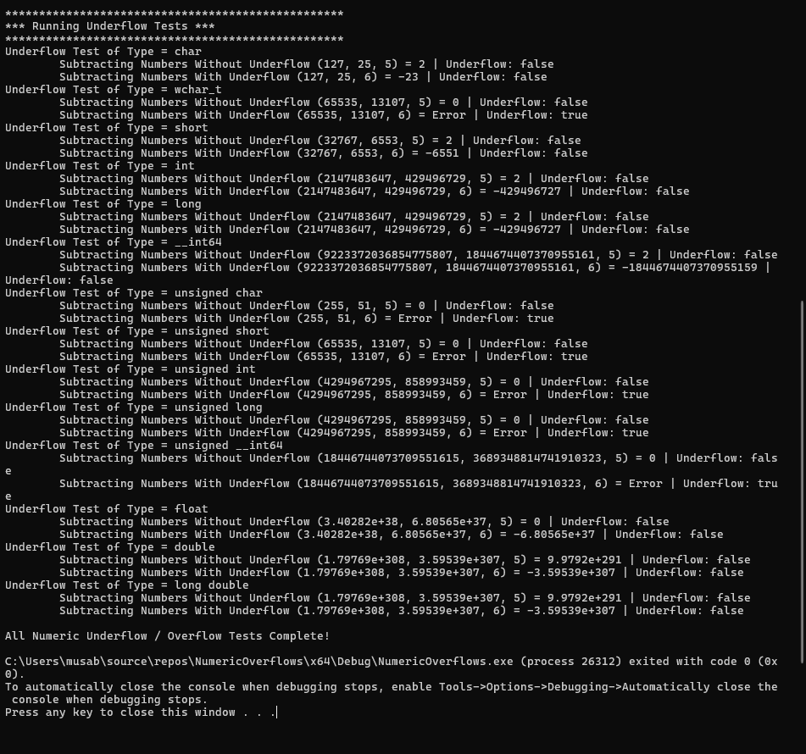
Unit Testing: Numeric Overflow Test
Is numeric overflow detected properly?
Content:
Vulnerability: Numeric overflow or underflow in arithmetic operations
Test Case: Add and subtract values near std::numeric_limits
Expected Result: Overflow/underflow is detected and prevented
Result: Test passed - safe bounds checking confirmed
Notes:
“This test checks for overflow using boundary values. The program handled the limits correctly, confirming that numeric operations are safely bounded.”

Slide 9
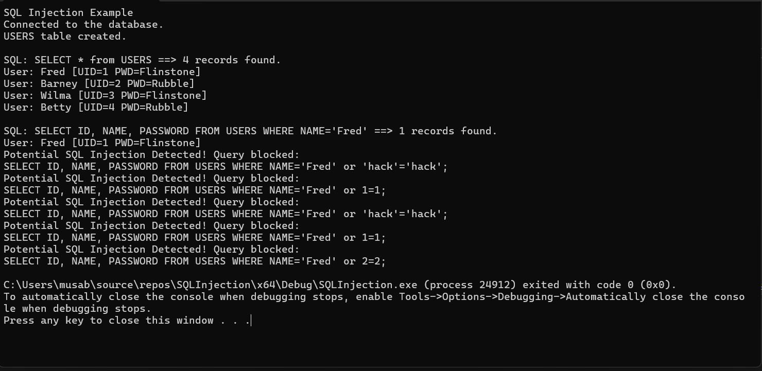
Unit Testing: SQL Injection Test
Can SQL injection be blocked?
Content:
Vulnerability: SQL Injection using OR 1=1 patterns
Test Case: Attempt malicious query like SELECT * FROM users WHERE name='x' OR 'x'='x’
Expected Result: Injection blocked, query rejected
Result: Test passed - regex detected injection attempt
Notes:
“Here, a test query with 'OR 1=1' was blocked using input validation. This confirms that the system successfully detects and prevents SQL injection.”

Slide 10
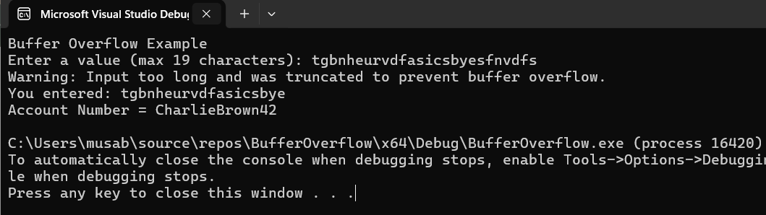
Unit Testing: Buffer Overflow Test
Is buffer overflow prevented in input handling?
Content:
Vulnerability: Stack corruption from oversized user input
Test Case: Input longer than 19 characters to char array
Expected Result: Input is safely truncated and warning shown
Result: Test passed - std::cin.getline() and stream clearing prevented overflow
Notes:
“This test used oversized input to check for buffer overflow. The use of getline and input clearing ensured safe handling, with no overflow occurring.”

Slide 11
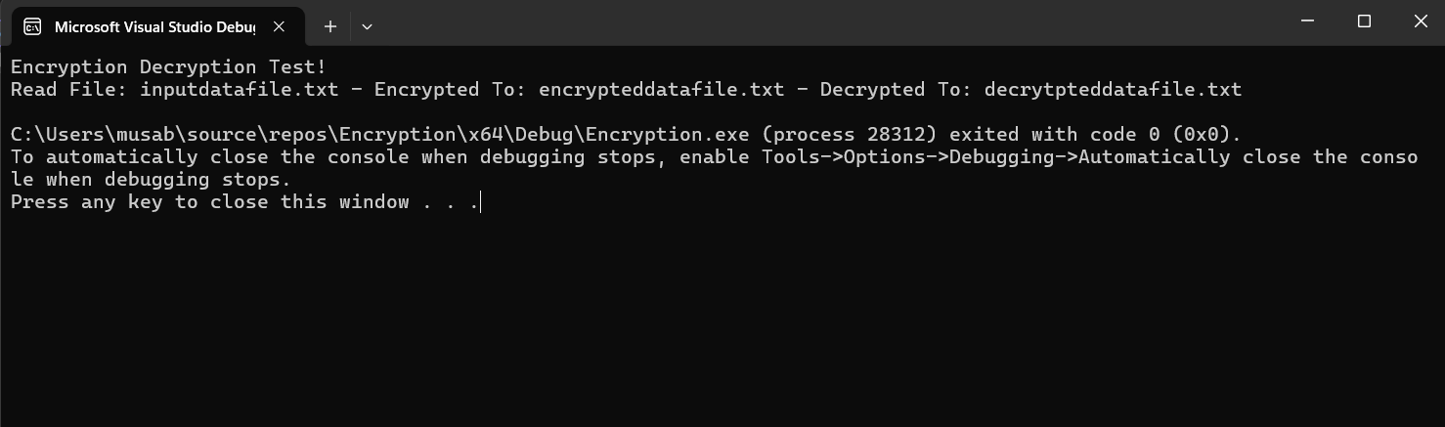
Unit Testing: Encryption Test
Is XOR encryption and decryption reversible?
Content:
Vulnerability Tested: Data exposure without encryption
Test Case: Encrypt then decrypt a text file using XOR
Expected Result: Output matches original after decryption
Result: Test passed — encryption/decryption confirmed functional
Notes:
“Using a basic XOR cipher, this test confirmed that encrypted files could be correctly decrypted, ensuring data is processed securely.”

Slide 12

AUTOMATION SUMMARY
The DevSecOps diagram illustrates how security tools are integrated across the development pipeline. In pre-production, static code analysis is performed during the build phase, followed by automated unit and vulnerability testing. Before deployment, configuration checks and penetration testing are conducted. Post-deployment, tools such as SIEM and intrusion detection systems monitor for threats. If issues are detected, response protocols like rollback or access blocking are triggered.
Notes:
“The DevSecOps diagram shows how security is built into every step of development. In the build phase, code is checked with static analysis and tested for bugs and vulnerabilities. Before release, configuration checks and penetration testing are conducted. After deployment, tools like SIEM and intrusion detection watch for threats. If issues are detected, response protocols like rollback or access blocking are triggered.”

Slide 13
TOOLS
The DevSecOps pipeline at Green Pace integrates security automation throughout pre-production and production phases. During the build phase, tools like Cppcheck and compiler flags detect code vulnerabilities early. Automated unit and compliance tests run in the verify and test stage. Before deployment, security settings and penetration tests are validated during the transition phase. Once in production, external tools for monitoring, such as SIEM, log collectors, and intrusion detection systems, ensure real-time alerts and auditing.
Notes:
“The DevSecOps pipeline at Green Pace integrates security at every stage. During the build phase, tools like Cppcheck and compiler flags catch code issues early. In the testing stage, we run automated unit and compliance tests. Before deployment, we check security settings and do penetration testing. Once the system is live, monitoring tools like SIEM and intrusion detection keep watch and send real-time alerts if something goes wrong.”

Slide 14
RISKS AND BENEFITS
Problems if delayed: Unpatched vulnerabilities could lead to exploits.
Benefits of acting now: Improved resilience, regulatory compliance, reduced breach risk.
Risks if skipped: Data loss, downtime, trust damage.
Action needed: Address high-priority issues first.
Notes:
“Delaying fixes can lead to breaches and downtime. Acting early improves compliance, reduces risk, and increases system reliability.”

Slide 15
RECOMMENDATIONS
Improve encryption in legacy systems.
Enforce consistent logging practices.
Automate static analysis and code reviews.
Regular security training for developers.
Notes:
“Recommended actions include upgrading encryption, standardizing logging, automating analysis, and providing regular secure coding training.”

Slide 16
CONCLUSIONS
Adopt Zero Trust models and frequent testing.
Align with OWASP, SEI CERT, and ISO standards.
Evolve policies based on emerging threats.
Integrate security from day one of development.
Notes:
“The policy supports secure development through zero trust, continuous testing, and alignment with OWASP and CERT standards. Security is integrated from day one.”

Slide 17

REFERENCES
CERT C++ Coding Standards: https://resources.sei.cmu.edu/downloads/secure-coding/assets/sei-cert-cpp-coding-standard-2016-v01.pdf
OWASP Top 10: https://owasp.org/Top10/
NHS Defense-in-Depth Diagram © 2019
GoogleTest Docs: https://github.com/google/googletest

